Slide 1
OVERVIEW S9k Self-Assessment System

Slide 2
Department of Health Inspections Annually
Food Service Operations Daily
Health Department inspections are a pinpoint in time. Have a passing score today and cases of foodborne illness in your operation tomorrow.
The key to maintaining a solid food safety operation is repeatability and continuity.
Many health departments offer a self-assessment for daily, weekly, monthly self-inspections.
Sentry9000 has adapted one of these self-assessments to its Android app/Web Browser application.
Measureable points for temperatures and visual observations for sanitation and other standards.
Out of limit measurements automatically generate an action needed prompt for corrective action.
This provides daily, weekly and monthly continuity and repeatability for the operation.

Slide 3
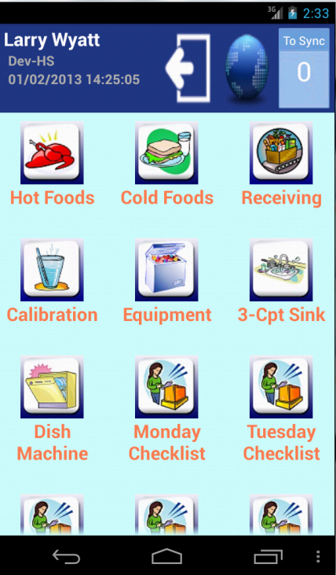
S9k HACCP & Food Safety System Android App Client Web Site Off-Site Database

Slide 4
Login Screen
Employee login is entered and the Login button is selected. This provides a digital signature. Each time a form is opened, it gives a time, date and digital signature.
This will move the program to the Main Menu Page.

Slide 5
Main Menu Page
There are icons to select for the forms to be completed.

Slide 6
Two Type Formats for Cooked Food Temperatures
Specific Menu Item
Generic Menu Item

Slide 7
Corrective Action Forms Corrective Action forms are automatically generated when an incorrect answer is submitted. If a menu item such as chicken requires a finished temperature of 165F, and the recorded temperature is only 160F, a Corrective Action Form is automatically generated and must be completed to continue with the next item. All questions that affect HACCP and food safety have a Corrective Action form associated with them. This information is then recorded on the web site as an Incident. It will show that it has been addressed because it must be addressed on the tablet to continue with the program. The following slides will go through a procedure that causes a Corrective Action form to be automatically generated.

Slide 8
Temperature Limit Screen
This shows the minimum temperature the food has to be cooked. Note that it is 165F. (The 250 is a random number for the high temperature that is needed for the form)
This tells the employee what the correct temperature for that menu item is. It also tells the program what the correct temperature is. If that temperature is not reached, then there will be a Corrective Action form automatically generated to describe the steps to take.

Slide 9
Temperature Entry
The temperature is manually entered using the numeric keyboard.
Sentry9000 offers a Bluetooth Temperature Probe that automatically sends the temperature to the screen. (See next slide)
This provides for flexibility in using this app for food safety.

Slide 10
Bluetooth Infra-red Temperature Probe (optional)

Slide 11
Cooked Food Corrective Action Form
A Yes answer to continue cooking.

Slide 12
Action Requirement
If a specific corrective action is not indicated by choosing a YES answer, then the program generates the following message.
The employee must choose YES for one of the corrective action answers for the program to proceed.

Slide 13
Digital Data Form as shown on a web browser

Slide 14
Have your own paper forms?
Sentry9000 can digitize them for you so you can eliminate all those sheets of paper, clipboards, notebooks, file folders, file cabinets, storage boxes, shredding, and the list goes on and on and on…………………………………………………………….

Slide 15
Save
Time
No forms to copy, store, complete, store longer, find, shred.
Money
No forms to copy, store, complete, store, shred. Push the ON button.
Data stored on secure server and available on secure web site at your fingertips on a computer, tablet, smartphone, even your computerized POS.
Credibility
Each form is date and time stamped with a digital signature of the employee performing the tasks.
Flexibility
Use your forms. Use our forms. Use both. Add all types of paper forms that are currently used for checks and checklists and accountability.

Slide 16
Home Page This is where the infrastructure is established with menus , vendors and employees. It shows all actions that occur on the app as well as creating reports. The Control Points section is for WiFi sensors for walk-in coolers and freezers which are available from Sentry9000.

Slide 17
Dual & Single WiFi Sensors for Coolers and Freezers

Slide 18
Data Control Point for Coolers and Freezers

Slide 19
S9k Self-Assessment System This self-assessment form is based on the FDA’s U.S. Food Code. A 7” Android Tablet is recommended. The forms on the app can be modified to meet your specific requirements. Your current forms can be created digitally to replace, or add to, the existing forms. The app/ web/ server software is free. There is an annual ($300) or monthly ($30) service charge for the data storage, the 24/7 telephone and email technical support, and for the software upgrades for the app, the web site and the server software. A webinar can be scheduled to provide you more information on the system. PowerPoint presentations for the Self-Assessment Android App and the Web Site Overview are available at http://sentry9000.com/S9kSSApp 800.519.7657 info@sentry9000.com http://sentry9000.com

