Slide 1

OVERVIEW
S9k Home Page Review

Slide 2
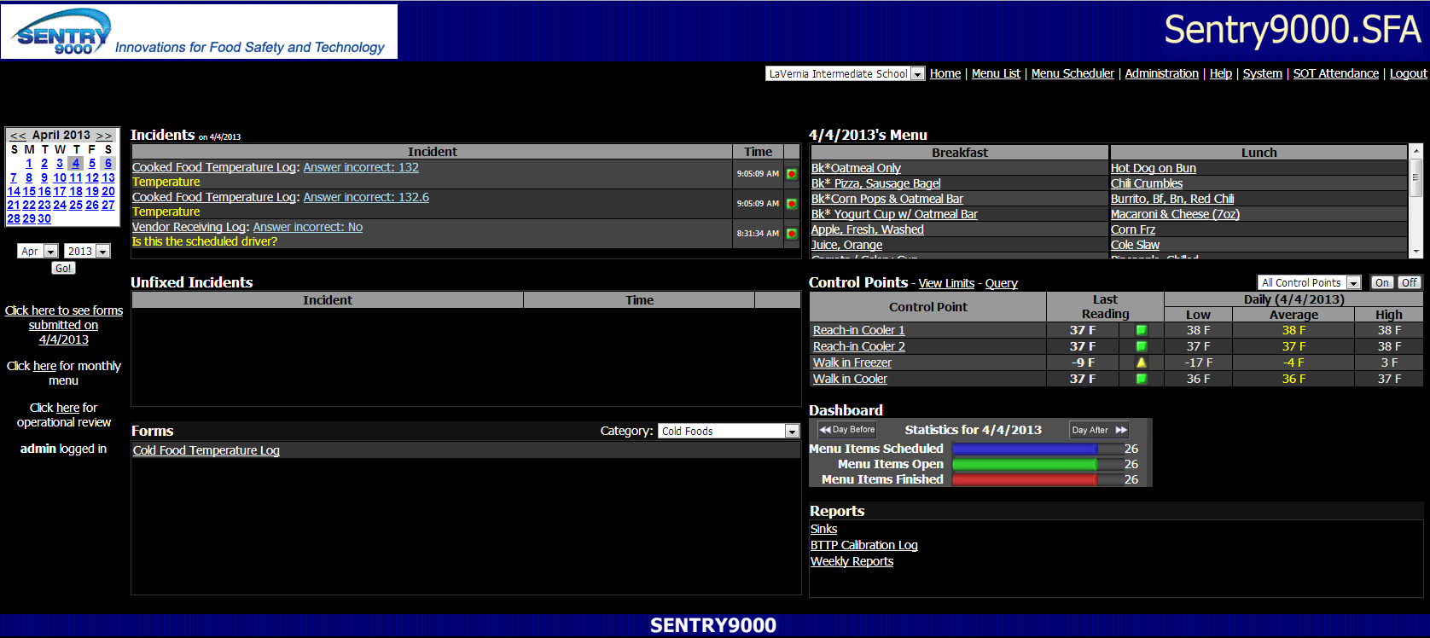
Home Page
The presentation will dissect each section of the Home Page.

Slide 3
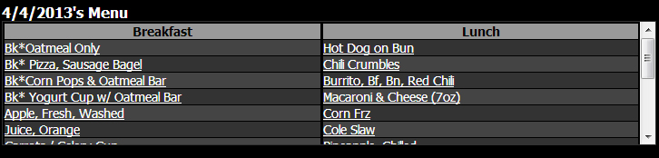
Today’s Menu
This shows the menu items scheduled for today. They are the same items that are on the Menu List.
The menu is divided into the different meals scheduled.
The Menu Items also provide a link to the Menu Item’s Job Info Form. Shown on next slide.
The Job Info Form is opened by selecting the Menu Item name.

Slide 4
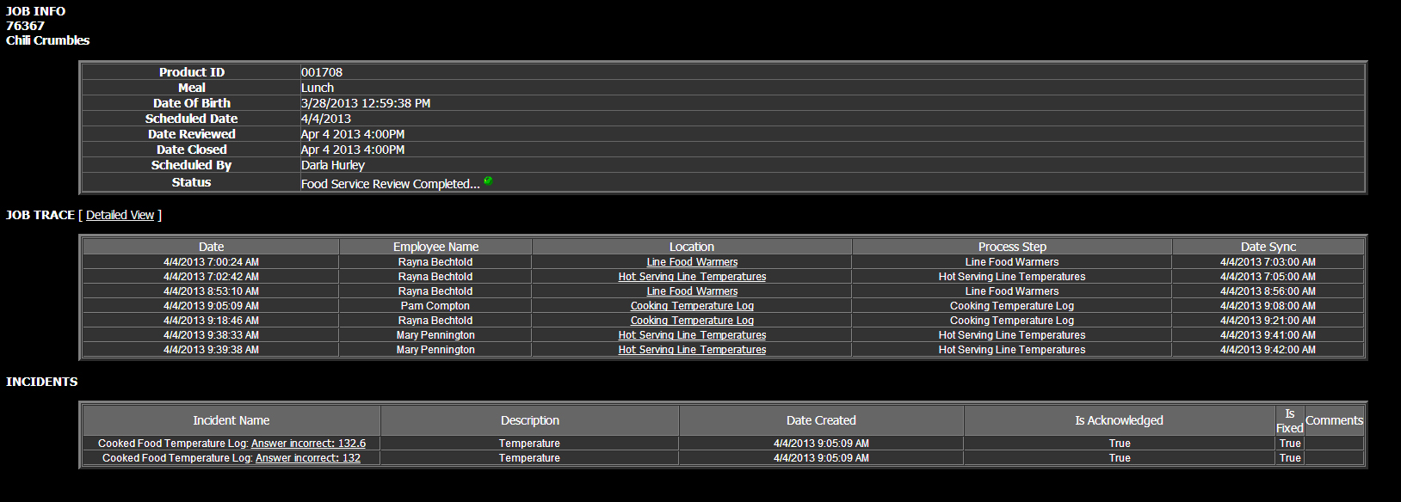
Job Info Sheet
The Job Info sheet provides scheduling information in the top section. The Job Trace section shows which forms were directly created for this menu item as well as ancillary forms such as the Food Warmer temperatures for hot foods and Cooling Unit temperatures for cold foods. The detailed view is shown on the next slide.
Incidents are shown on the last section. This links to the form data for that particular incident to provide detailed data.

Slide 5
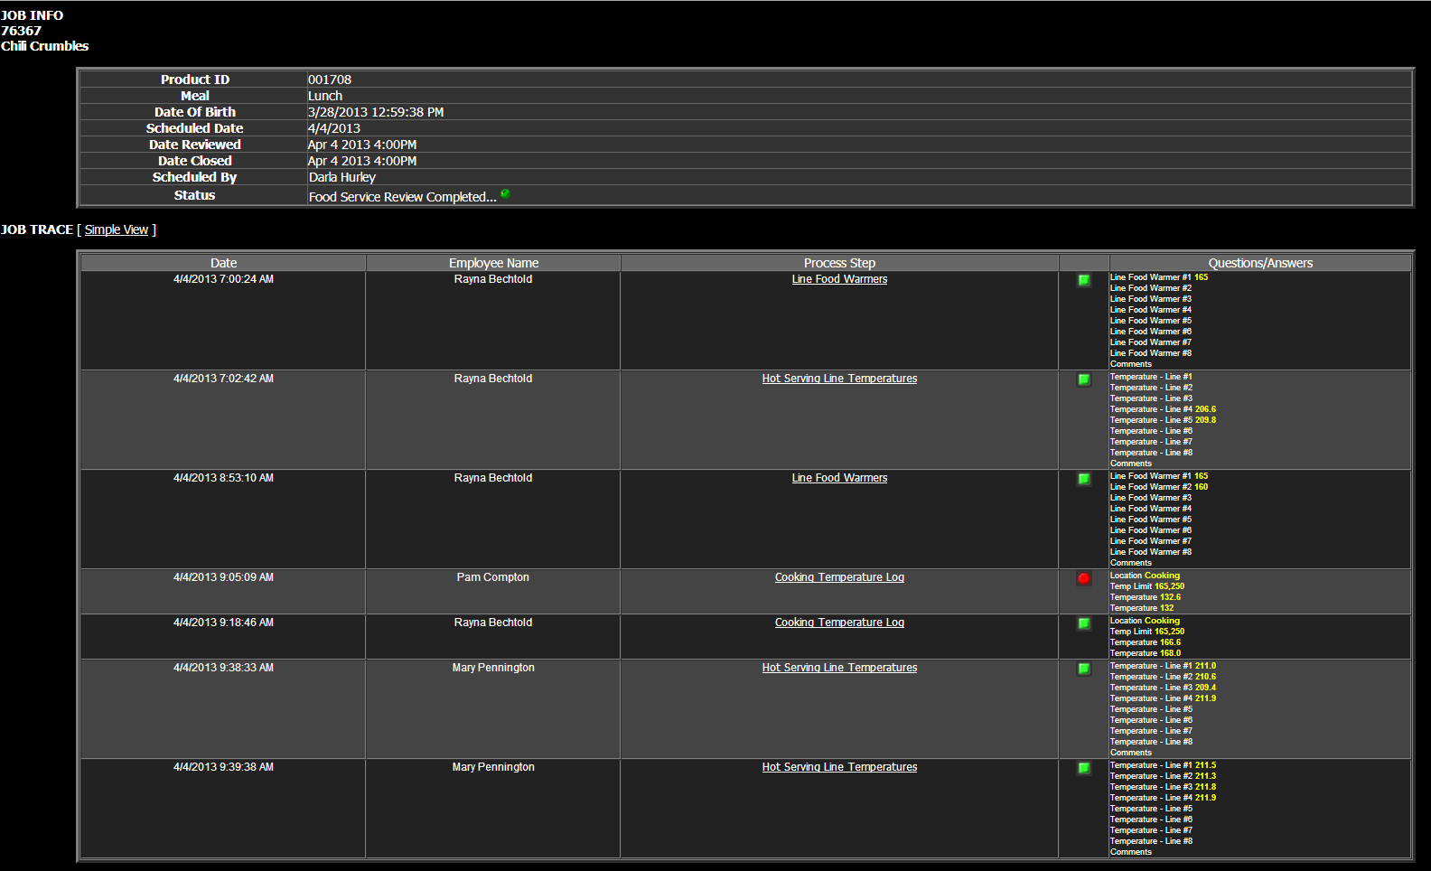
Detailed Job Info Sheet
Note the form data is shown in the detailed view. The Process Step also provides a link to the form data that is shown under Questions/Answers.

Slide 6
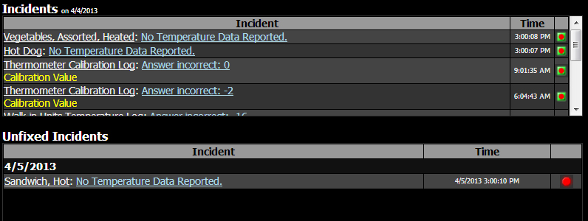
Incidents
When a corrective action is needed for a low or high temperature or a No answer when a Yes is required, the form is recorded as an Incident.
An Incident needing a corrective action is shown as a red circle and the form needs to be completed on the web site. When completed, it will show a green square surrounding the red circle.
An incident that occurs on the app is corrected on the app so it is shown as a red circle surrounded with a green square.
An Incident that does not receive a Corrective Action today stays in the Unfixed Incident section until it is completed. The Incident section is cleared automatically at midnight. The Unfixed Incidents section is not cleared. Removal only occurs when corrected.

Slide 7
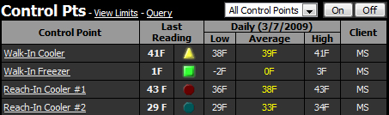
Control Points
The Control Points section displays temperatures from the temperature sensors.
Visual indicators are red, yellow, green and blue.
Green means the temperature is within the prescribed limits.
Yellow means the temperature is within 2 degrees of high or low preset.
Blue means the temperature is below the minimum preset.
Red means the temperature is above the maximum preset.

Slide 8
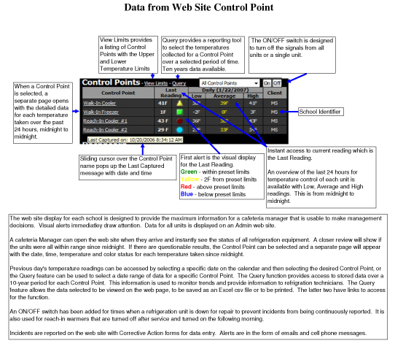

Slide 9
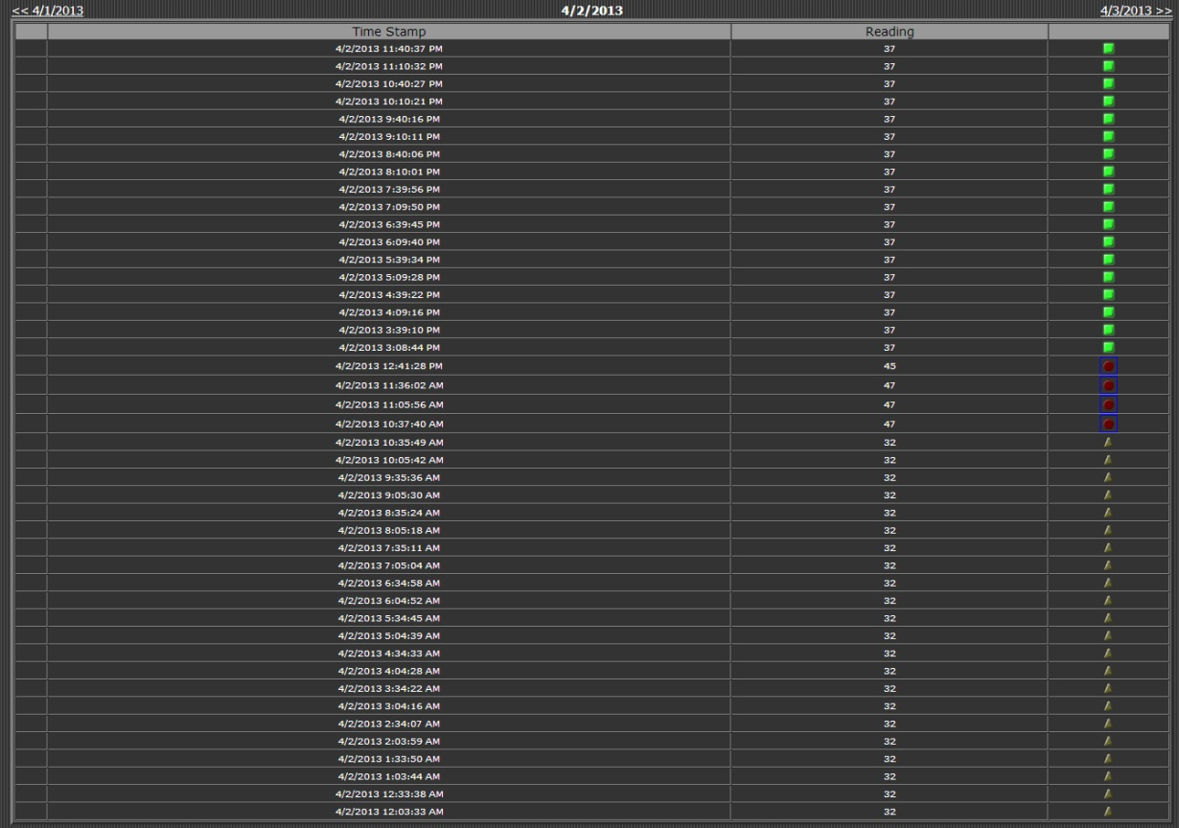
24-hour Review
When the Control Point name of the refrigeration unit is selected, it opens the 24-hour review page. This page shows all temperature readings from midnight to midnight. Each day is accessible by selecting the date in the top left corner.

Slide 10
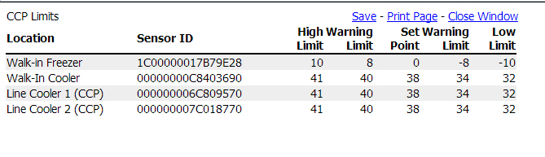
View Limits
The View Limits link on the top of the Control Points opens the information screen that shows the preset limits for each of the refrigeration units.

Slide 11
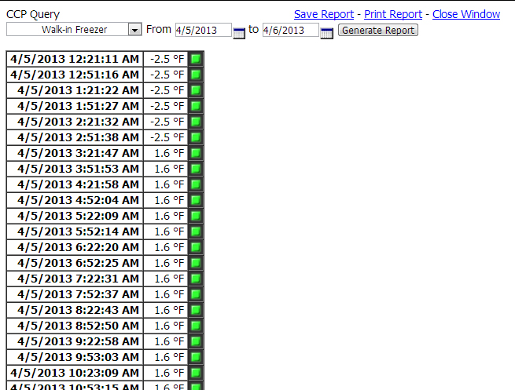
Query
A query for a date range for a single refrigeration unit can be obtained by selecting the Query link on top of the Control Points section.
Select the From/To Date Range and then Generate Report.
There are links to save the report or to print the report. Both options are in spreadsheet format.
The Save Report also allows functions to be created for the data in the query such as graphing, sorting, averaging, etc.

Slide 12
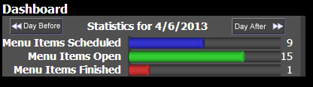
Dashboard
The Dashboard is used to monitor leftovers and manual closing of menu items.
Menu Items Scheduled are the number of menu items scheduled for today.
Menu Items Finished are the number of menu items closed for today.
Menu Items Open are today’s menu items in addition to all the leftovers that are in the system.
Selecting the colored bar shows the directory of menu items for that category.

Slide 13
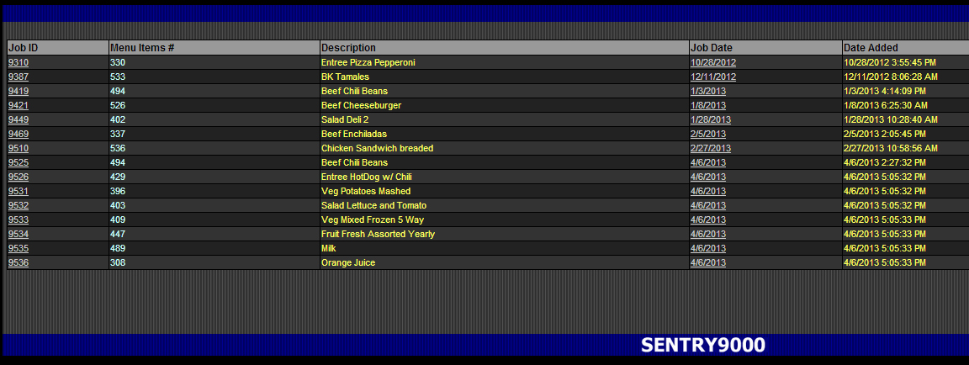
Leftovers
Leftovers are created when the CCP Cooling Log form is used to record the cooling temperature of hot foods. The menu items that go through the CCP Cooling Log are not automatically removed from the menu list.
By selecting the item date under the Job Date column, the menu list with that leftover is opened for viewing.
Manual closing can be conducted at this point.

Slide 14
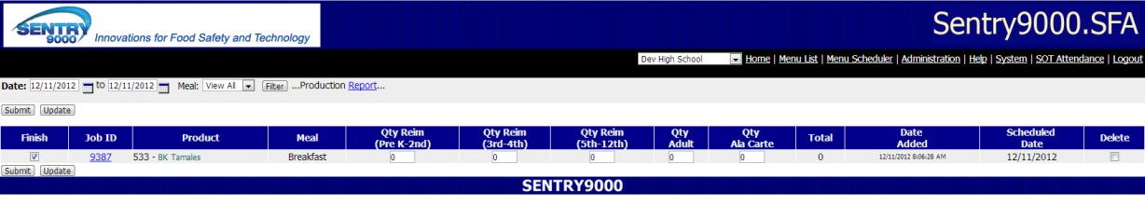
Leftover Menu List
When the Job Date is selected on the Menu Items Open directory , that dates Menu List will open and display the leftovers available from that date.
To Manually Finish this menu item, check the box on the left of the menu item in the Finish column and then select Submit.

Slide 15
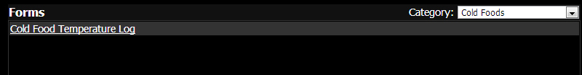
Forms
The Forms section is the catalog of each forms. The form data is available for the complete history of the program.

Slide 16
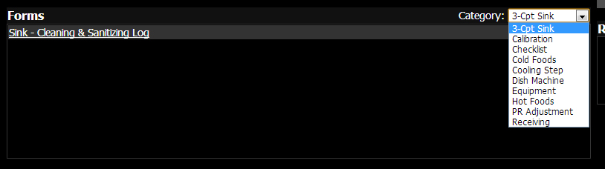
More Forms
The pull down menu shows a menu of forms based on categories.
Select a category and all the forms in that category will be available for view.

Slide 17
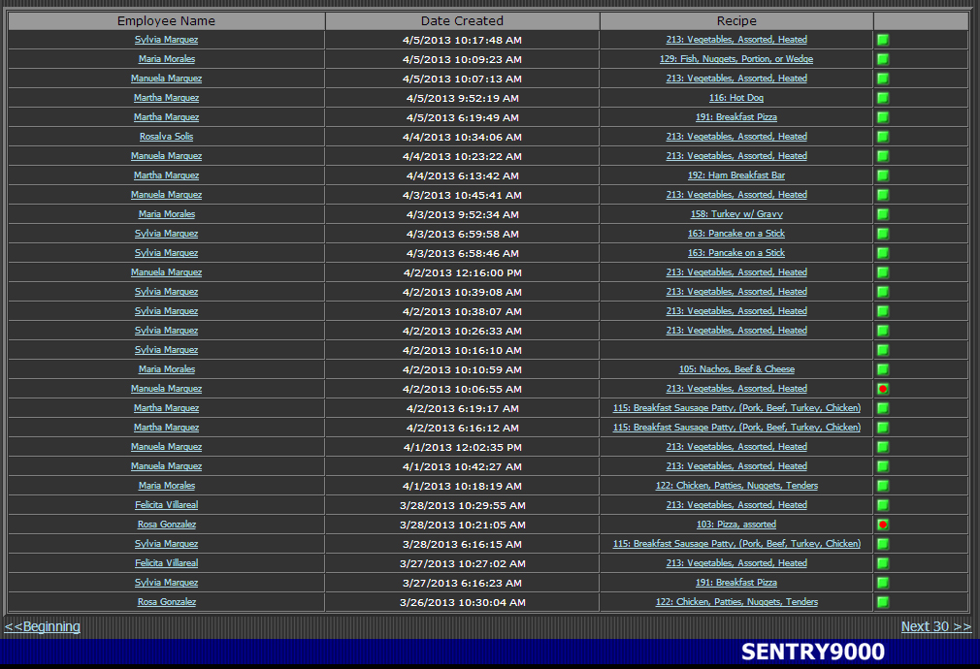
Form Data
This is the directory of form data that is available.
It shows the employee, the date and time and status.
If it is a form for a food item, the menu item will be shown. Selecting the employee’s name will show the data for that specific incident.
Selecting the menu item will open the Job Info sheet.

Slide 18
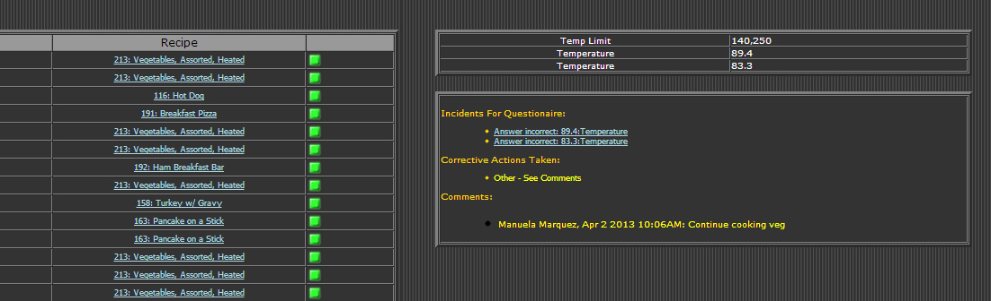
Selecting Employee Name for Specific Form Data
Note the data is reported and it is a lower temperature than the limit for this menu item.
This caused two incidents that required corrective action and they are shown in the second block under Incidents for Questionaire.
Selecting the Incident links will show the corrective action data entered as will be shown on the next slide.

Slide 19
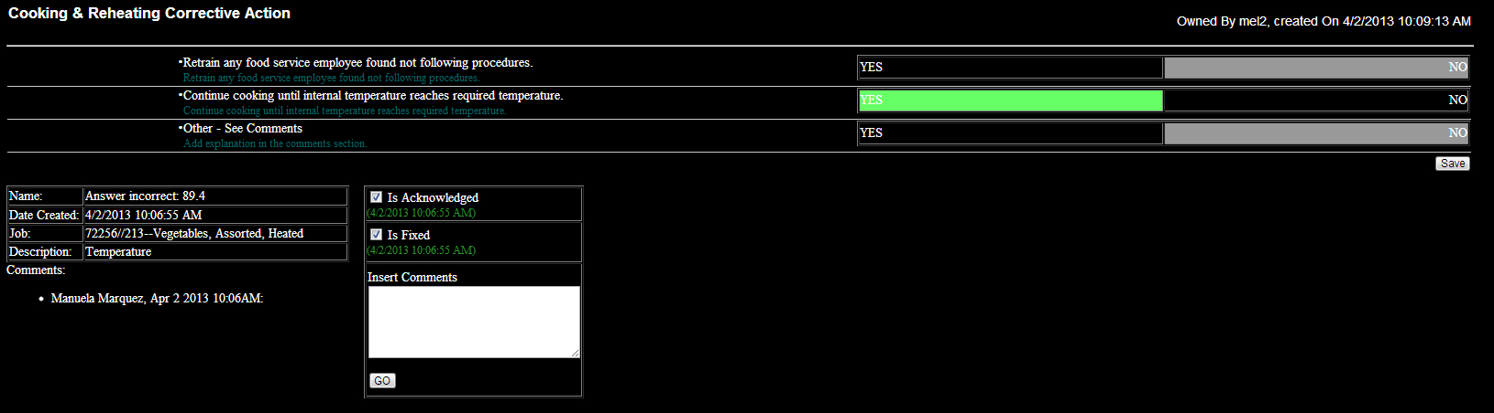
Corrective Action Web Form
Note that the second question was selected as the corrective action and that was to continue cooking until the proper temperature was reached.
Comments can also be inserted on the app and additional comments can be added to the web form.

Slide 20
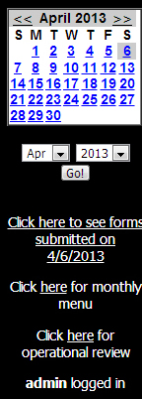
Calendar
The calendar allows the access to past data by selecting the month and date.

Slide 21
Submitted Forms Today
The first link below the calendar shows the forms submitted today.
That also works for past days.
More detail on next slide

Slide 22
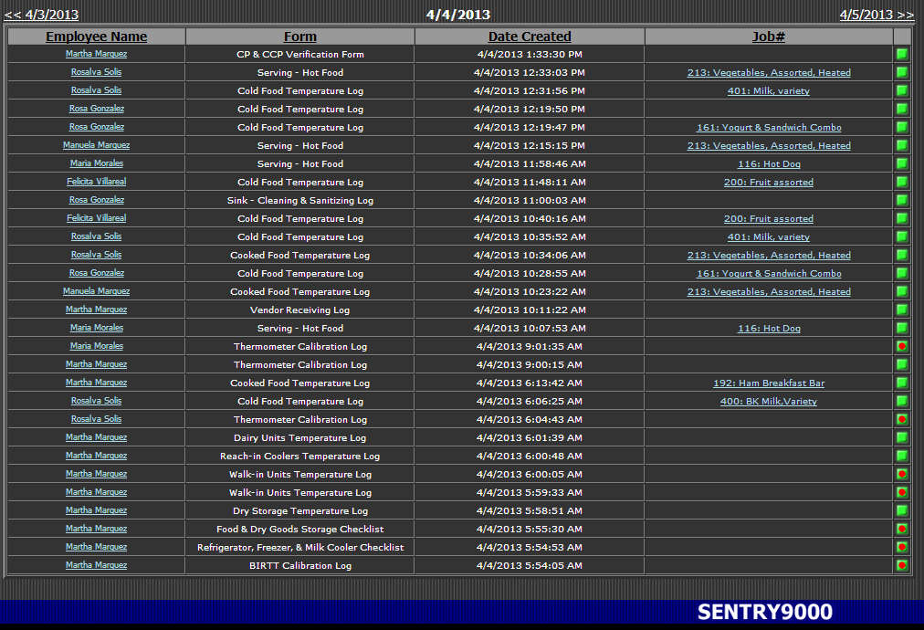
Daily Directory of Forms
This is a list of forms submitted through the day accessed by the first link under the calendar. Click here to see forms submitted today. The default sort is by time for the day. The forms are sortable by selecting the column heading. This provides a review for assuring that steps in food safety are being taken in the correct order and at the correct times.
Selecting the link for Employee and for Menu Item opens the same data as described earlier for the Cooking Form.

Slide 23
Monthly Menu
The second link under the calendar is to access the monthly menu that has been scheduled.
The next slide will show the Monthly Menu calendar.
This is an interactive calendar. For future dates by selecting the meal type, breakfast or lunch, it will open that menu list. This is valuable if you have to make known menu changes.
Selecting the menu item on past days opens the Job Info Sheet.

Slide 24
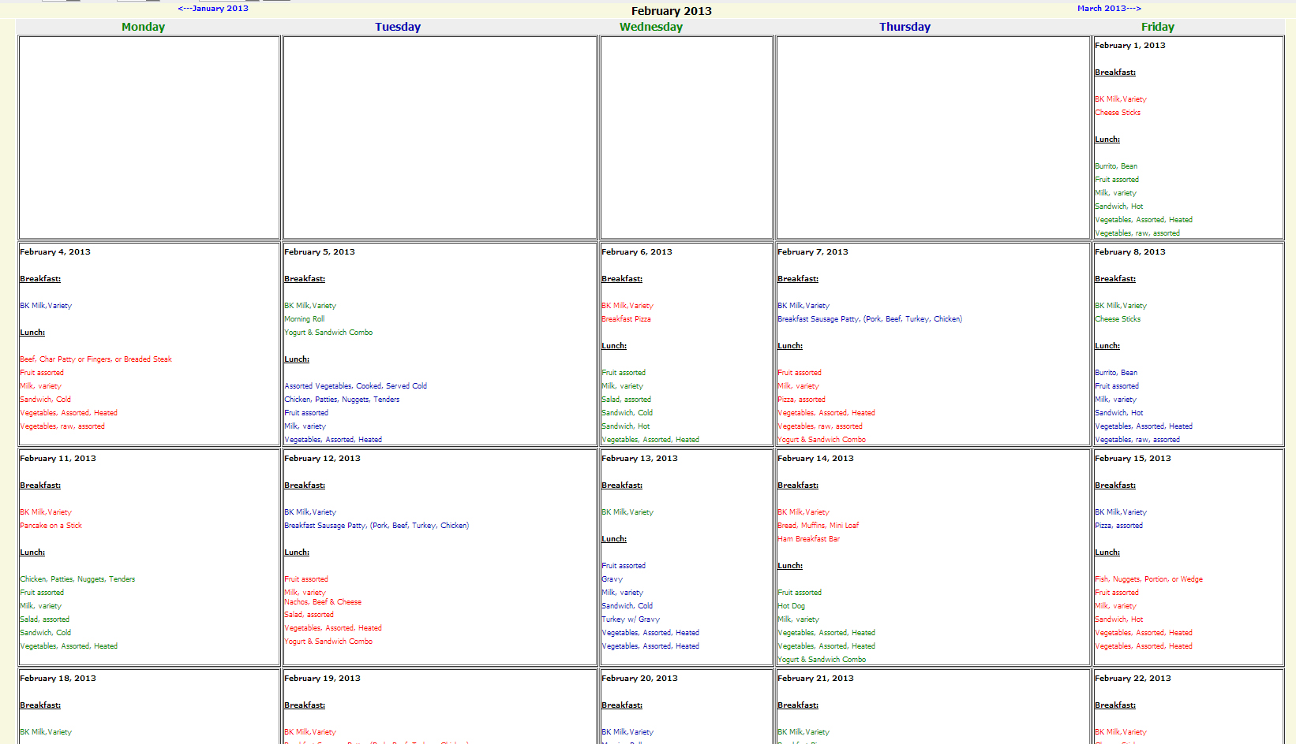
Monthly Menu

Slide 25
Operational Review
The third link is for the operational review.

Slide 26
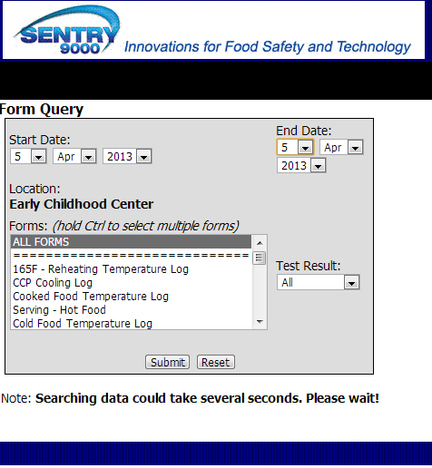
Forms Query
The All Forms selection shows all the forms submitted as shown in next slide.
Single forms can be selected such as those shown.
The date range defaults to today, but a date range can be set up to look at the forms for a specific time frame.
The Test Result menu allows filtering by All, Passed or Failed.

Slide 27
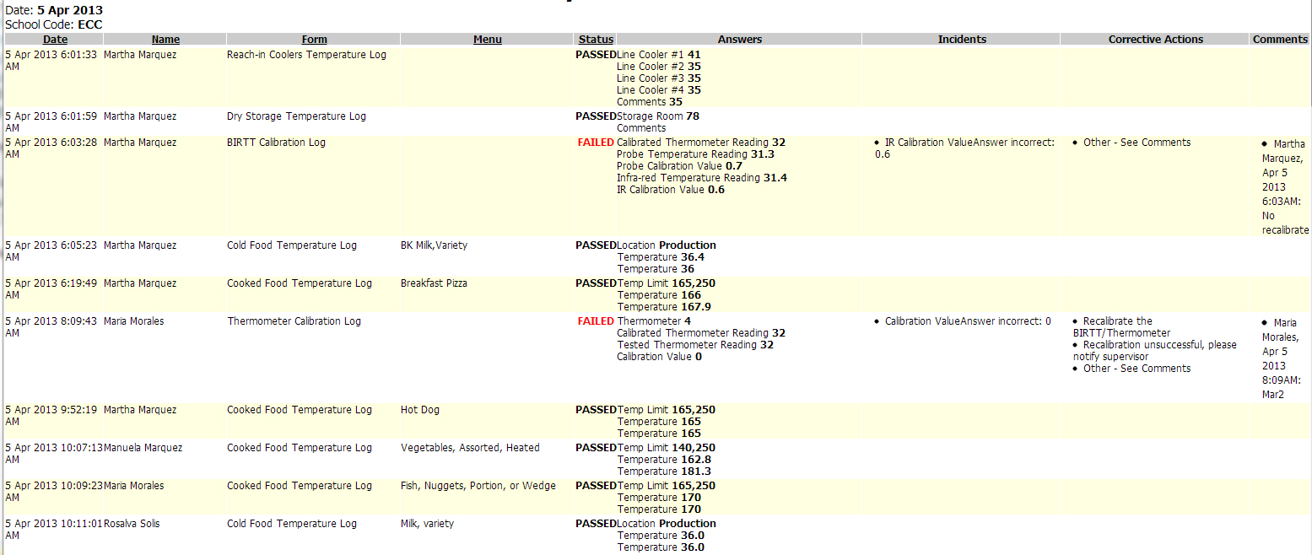
Operational Review
This is the third link under the calendar. It shows the complete data for all the forms submitted at any point in time. It shows the detailed data for each form. It shows the detail for Incidents and the corrective actions taken.

Slide 28
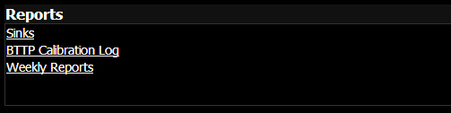
Reports
The reports section on the Home Page will be covered on the Reporting Tool section.

Slide 29
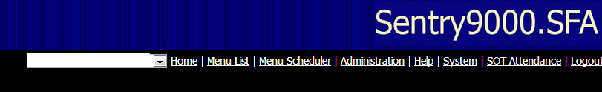
Links
The links in the top right of the Home Page will be addressed in other presentations.

Slide 30
Final Slide of this Session

