Slide 1
OVERVIEW S9k HACCP Android App Web Browser Program

Slide 2
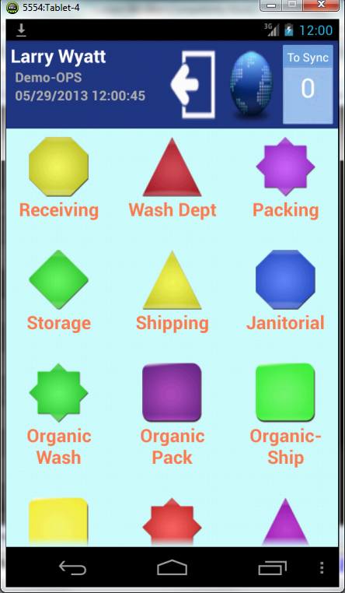
S9k Digital Data System Android App Client Web Site Off-Site Database

Slide 3
Login Screen
Employee login is entered and the Login button is selected. This provides a digital signature. Each time a form is opened, it gives a time, date and digital signature.
This will move the program to the Main Menu Page.

Slide 4
Main Menu Page
The different icons represent the different categories that are available. An icon can represent a single form or have multiple forms for selection.

Slide 5
4-Types Questions
There are 4-types of questions based on the format the answers are presented.
Yes/No – select the Yes or No button.
Text – Enter words or numbers for comments or answers requiring a specific value.
Multiple Choice Options – Options are provided for the answer. One is selected.
Temperature using the S9k Bluetooth/InfraRed Temperature Taker (BIRTT).

Slide 6
FSF 10.1D Pre-Op Receiving (Yes/No Answer)
The red arrow indicates the question number that is present on the screen and the total number of questions in the form.
The yellow arrow points to the (RQD) which means this is a required question and cannot be passed without answering.
The green arrow points to a Yes- No answer for this question. When the answer is selected the form moves to the next question.

Slide 7
Comments
This is a Comments question. Note there is not a (RQD) symbol so this is not a required question. It can be skipped.
Comments are added by using the on-screen keyboard

Slide 8
Multiple Option Answers
This is a multiple option answer. It allows the employee to select the correct motor number being inspected.

Slide 9
Temperature from BIRTT
Temperatures can be manually entered in a text question. Upper and lower limits can be set for the answer.

Slide 10
Action Needed and Corrective Action Forms Corrective Action forms are automatically generated when an incorrect answer is submitted. If a sanitizer requires a concentration of 200ppm, and the recorded concentration is only 100ppm, an Action Needed/Corrective Action Form is automatically generated and must be completed to continue with the next item. This information is then recorded on the web site as an Incident. It will show that it has been addressed because it must be addressed on the tablet to continue with the program. The following slides will go through a procedure that causes an Action form to be automatically generated.

Slide 11
Soda Ash Percent
Note the range of 2.5 - 4 on the question.
If the answer is outside this range, there will be an Action Needed form automatically created. The answer of 1.5 is outside of the range.

Slide 12
Submit creates Action Needed Form automatically
Submit
Action Needed Form appears

Slide 13
Action Needed
The red arrow shows the incorrect answer.
The yellow area points to an action to be taken.
Additional actions may follow. At least one of them must be selected by selecting the Yes answer to indicate what action is to be taken.

Slide 14
Action Needed Comments
Comments are optional.
Submit Actions taken.

Slide 15
Digital Data Form as shown on a web browser

Slide 16
Preventive Maintenance Provides automated scheduling for Preventive Maintenance, scheduled cleanings and more. Also monitors Open Ticket Items as they occur. Provides maintenance history of equipment.

Slide 17
Dual & Single WiFi Sensors for Coolers and Freezers

Slide 18
Real-Time Monitoring for Coolers and Freezers with Alarms and Alerts

Slide 19
S9k Android App Web Browser Program A 7” Android Tablet is recommended. There is a setup fee for the database, the web site and creating the categories, forms and questions for each location. There is an monthly service charge for the data storage, the technical support and software upgrades. A webinar can be scheduled to provide you more information on the system. 800.519.7657 info@sentry9000.com http://sentry9000.com

