Slide 1
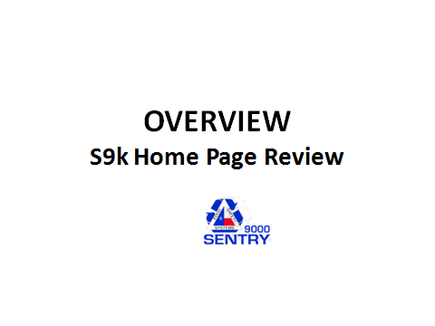

Slide 2
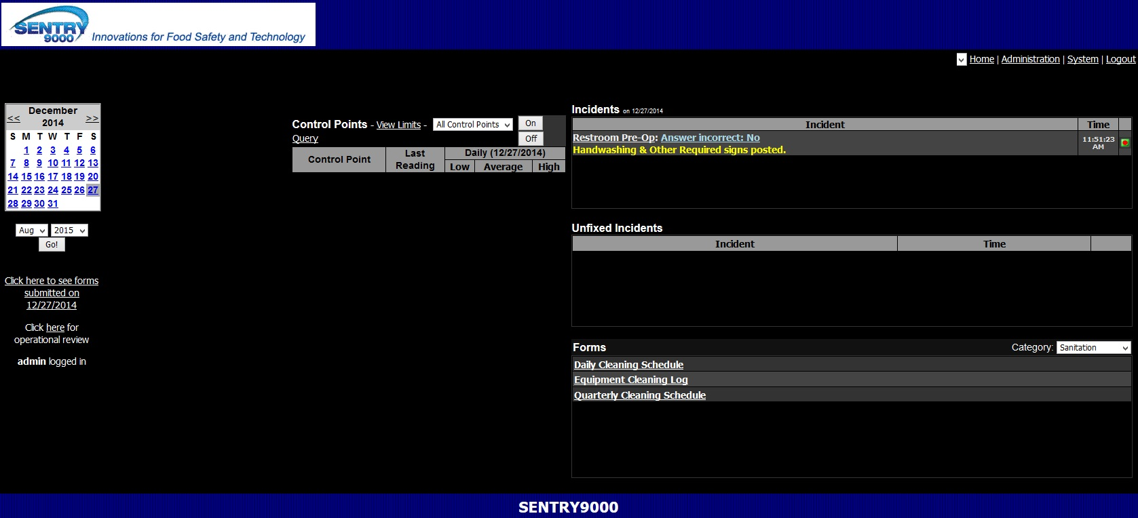
Home Page
The presentation will dissect each section of the Home Page.

Slide 3
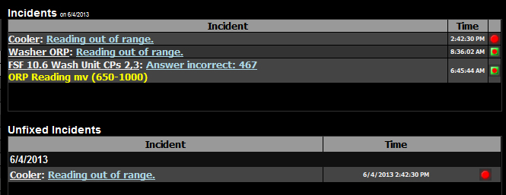
Incidents
When a corrective action is needed for a low or high temperature or a No answer when a Yes is required, the form is recorded as an Incident.
An Incident needing a corrective action is shown as a red circle and the form needs to be completed on the web site. When completed, it will show a green square surrounding the red circle.
An incident that occurs on the app is corrected on the app so it is shown as a red circle surrounded with a green square.
An Incident that does not receive a Corrective Action today stays in the Unfixed Incident section until it is completed. The Incident section is cleared automatically at midnight. The Unfixed Incidents section is not cleared. Removal only occurs when corrected.

Slide 4
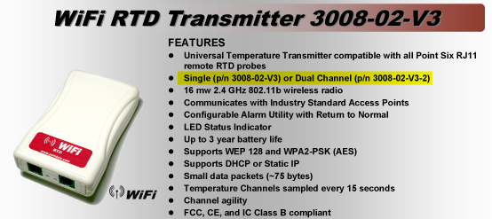
Dual & Single WiFi Sensors for Coolers and Freezers

Slide 5
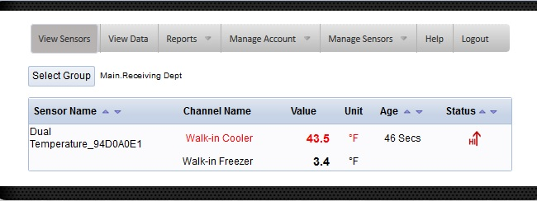
Monitor
Coolers and Freezers

Slide 6
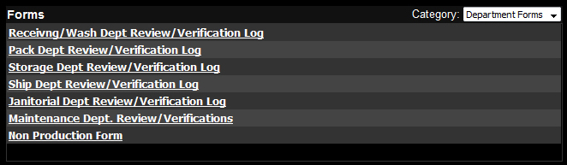
Forms
The Forms section is the catalog of each forms. The form data is available for the complete history of the program.

Slide 7
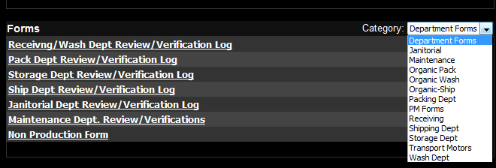
More Forms
The pull down menu shows a menu of forms based on categories.
Select a category and all the forms in that category will be available for view.

Slide 8
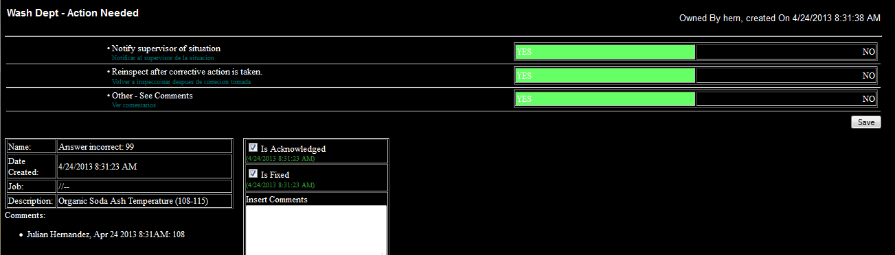
Corrective Action Web Form
Note that all questions were selected to complete the corrective action.
Comments shows 108 as the temperature after re-inspection. Additional comments can be entered into the Comments section as the action proceeds.

Slide 9
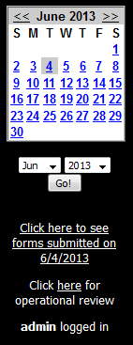
Calendar
The calendar allows the access to past data by selecting the month and date.

Slide 10
Submitted Forms Today
The first link below the calendar shows the forms submitted today.
That also works for past days.

Slide 11
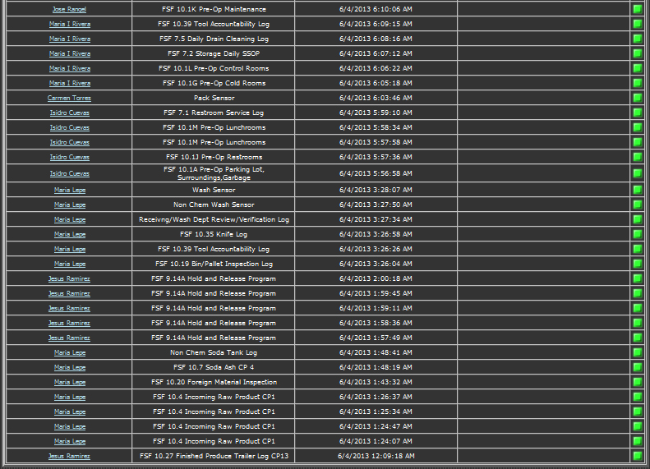
Daily Directory of Forms
This is a list of forms submitted through the day. The default sort is by time for the day. The forms are sortable by selecting the column heading. This provides a review for assuring that all steps are taken and taken when scheduled.
Selecting the link for Employee and for Menu Item opens the form data as described earlier.

Slide 12
Operational Review
The next link is for the operational review.

Slide 13
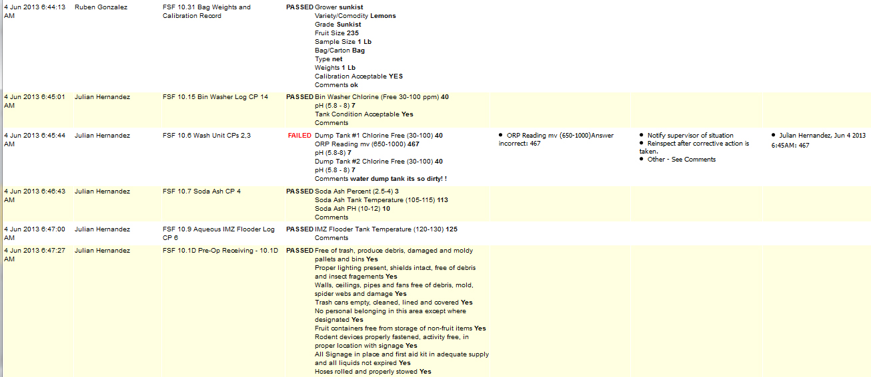
Operational Review
This is the third link under the calendar. It shows the complete data for all the forms submitted at any point in time. It shows the detailed data for each form. It shows the detail for Incidents and the actions needed.

Slide 14
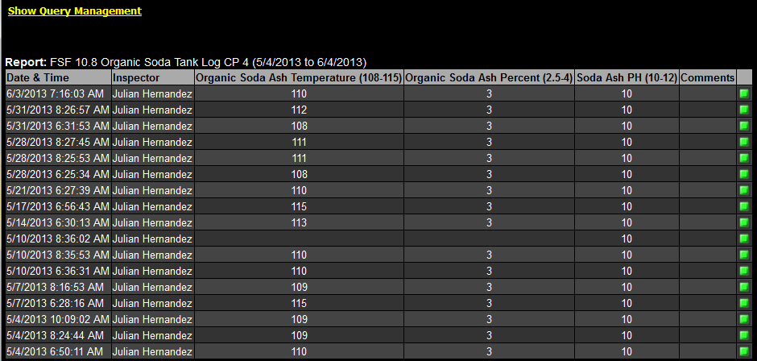
Reporting Tool
The Reporting Tool provides columnar reports of all form data. It can be copied to Excel for functions and for graphing. The Query Management Option allows for pre-set reports to be generated daily.

Slide 15
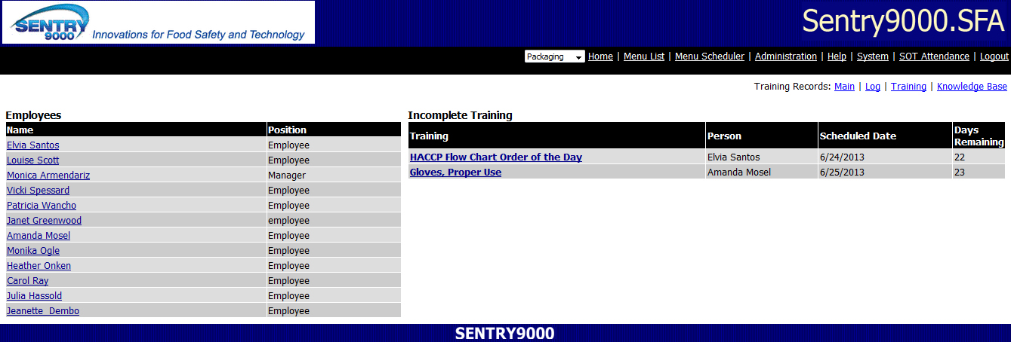
Employee Training Records
Provides permanent training records for employees. Shows individual trainings scheduled for each employee. History of training is available for each employee. Can be used for documenting deficiencies for employees as this is a training necessity.

Slide 16
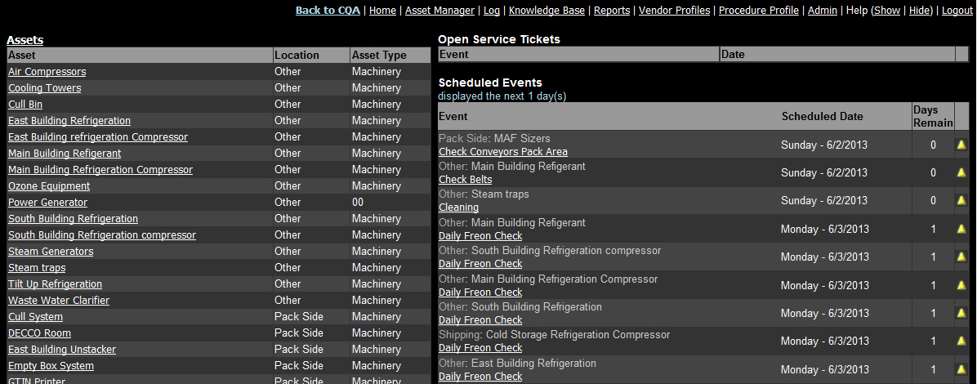
Preventive Maintenance
Provides automated scheduling for Preventive Maintenance, scheduled cleanings and more. Also monitors Open Ticket Items as they occur. Provides maintenance history of equipment..

Slide 17
Final Slide of this Session

